Slide 1


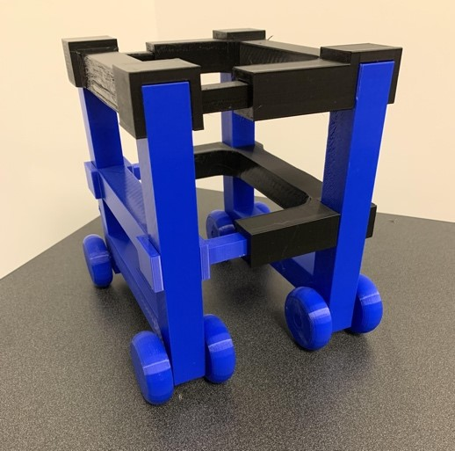
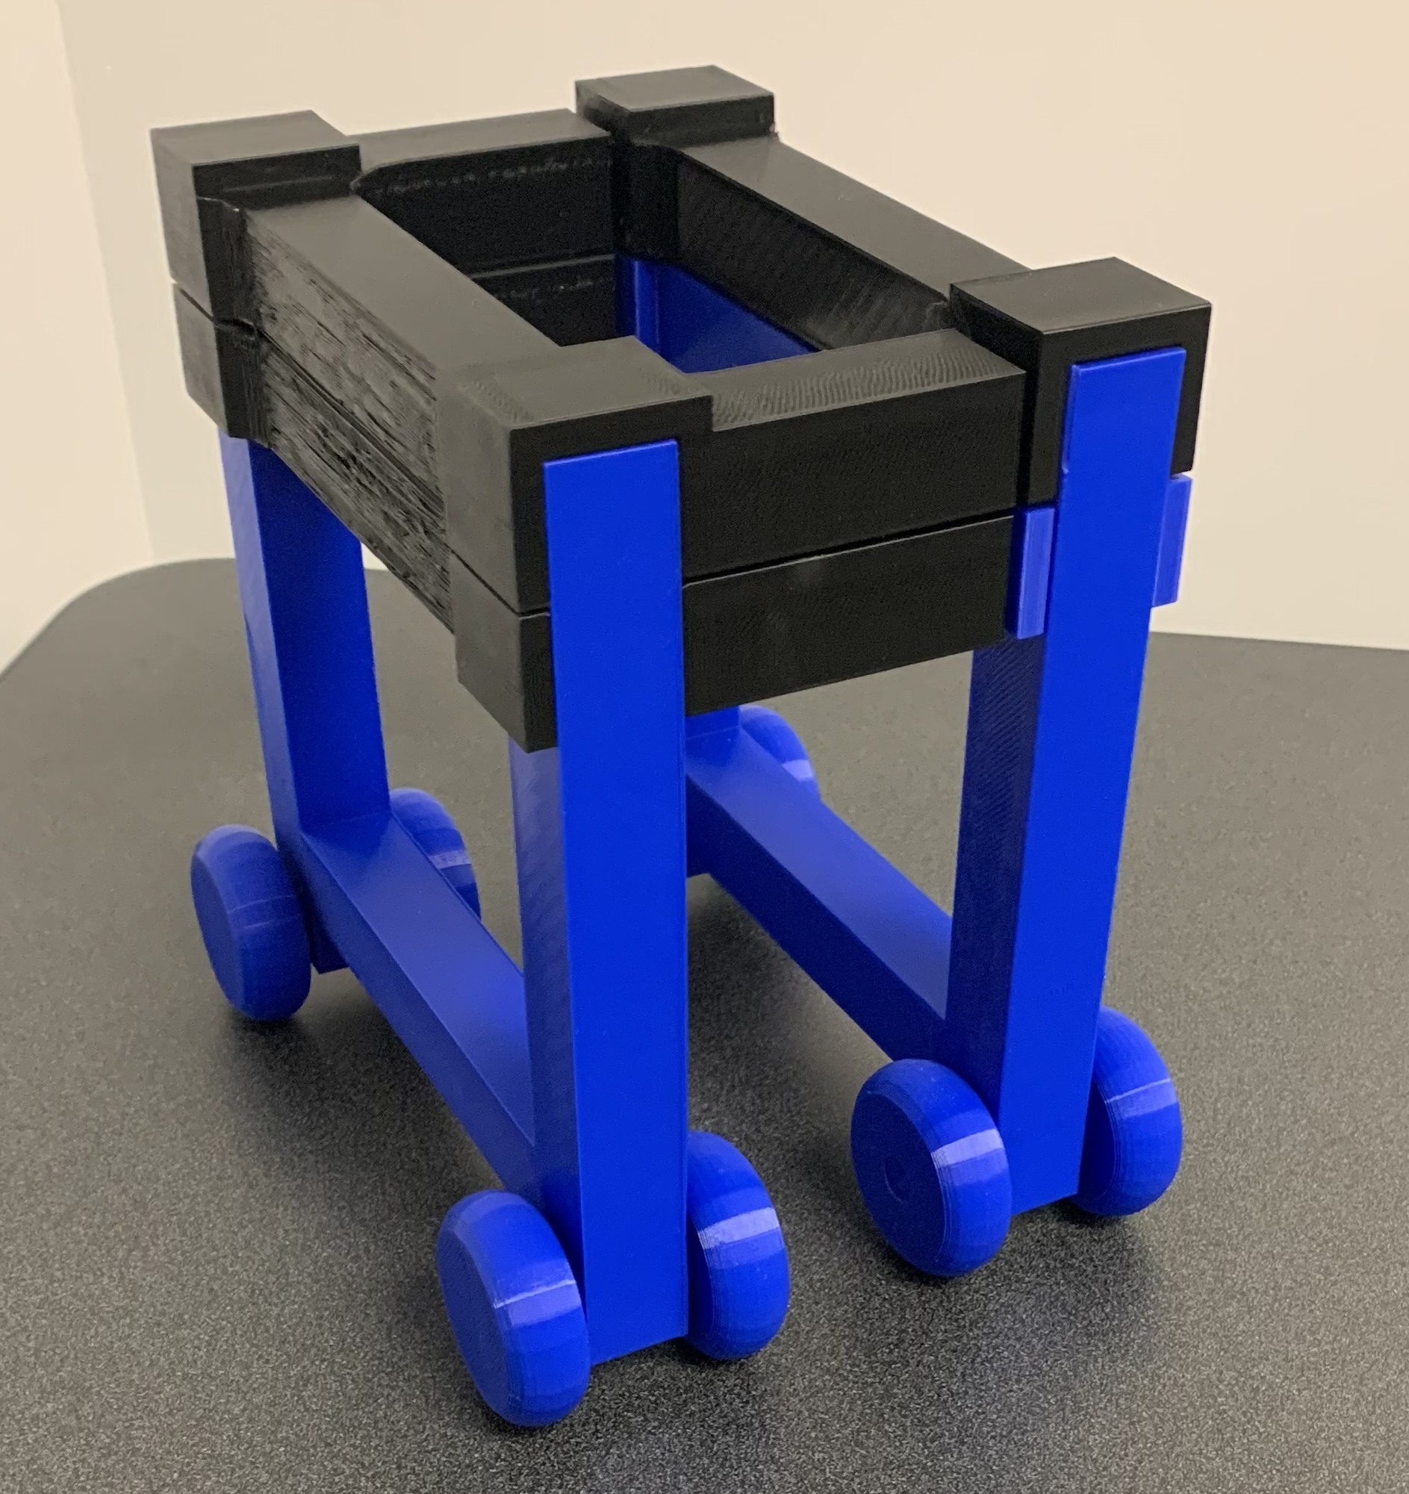



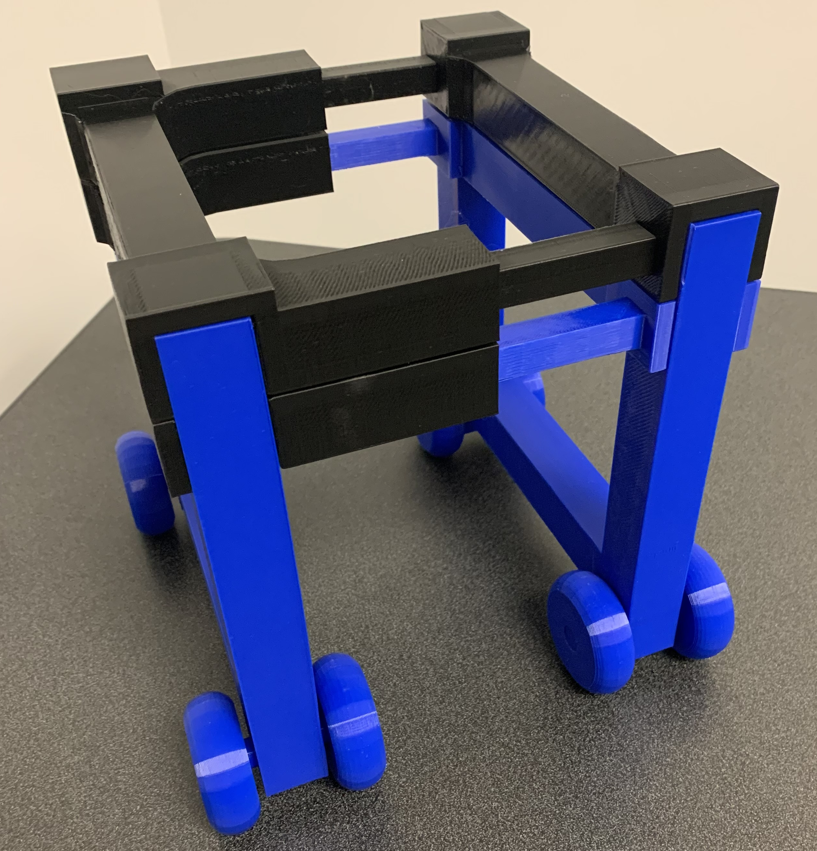



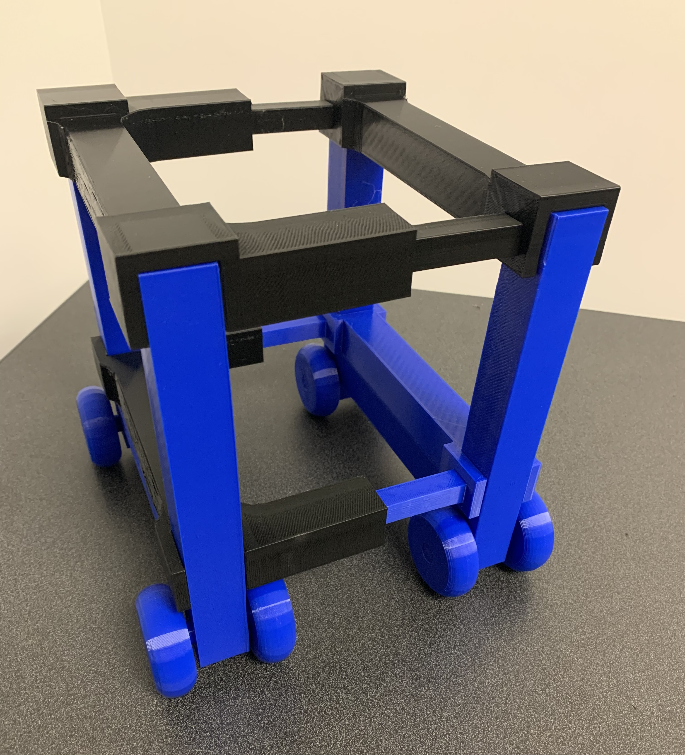



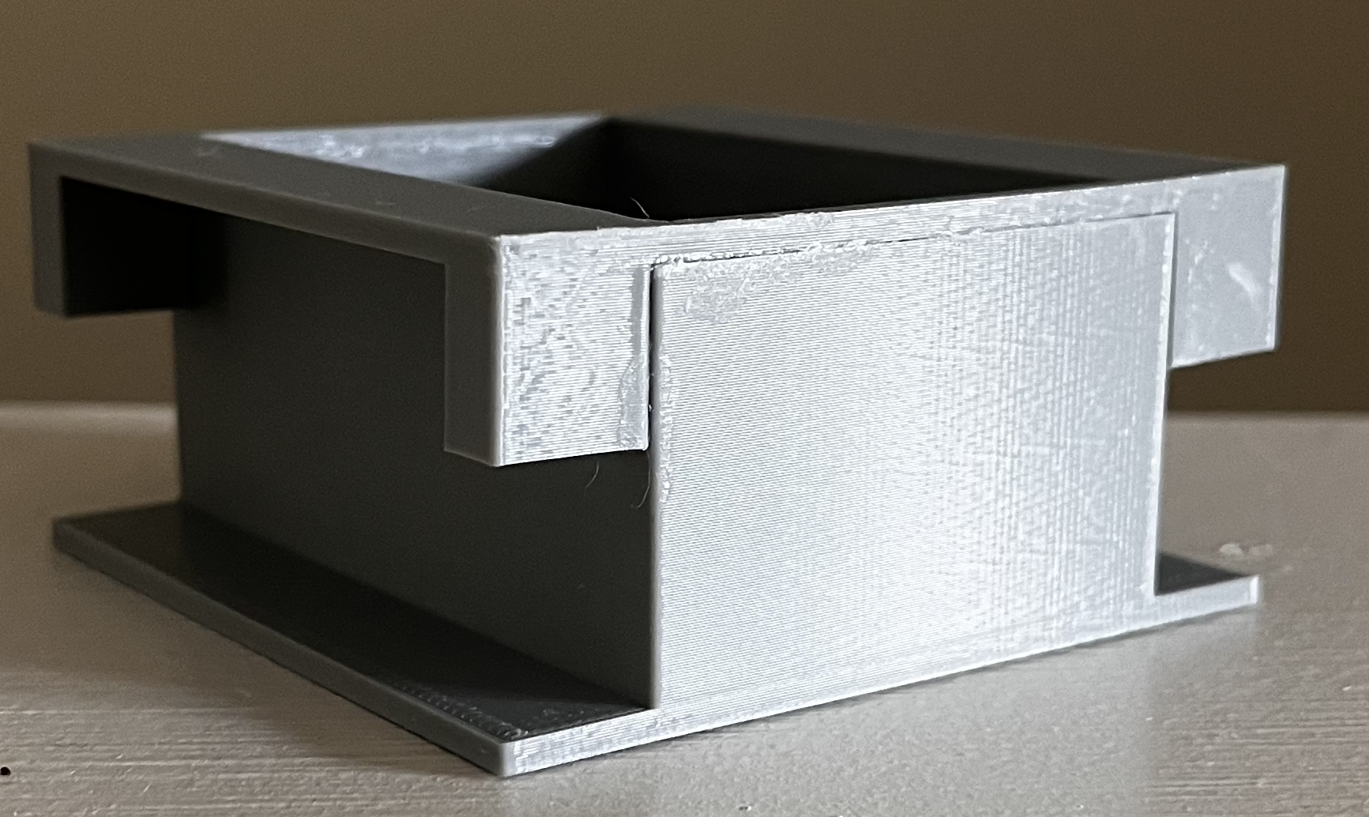


Lunar Heavy Payload Lift and Transport
Team 517 | Cameron Barnes | Cole Gutknecht | Tyler Ince-Ingram | Rafael Meza | Michael Wyrick | Sponsor: Arthur Werkheiser | Adviser: Dr. William Oates
Objective
Current State of Design
Key Targets
Initial Prototype
How it Works
Transport heavy loads on the lunar surface between the landing site and habitation area .
1
Device reduces size to compact into rocket cargo bay.
Lifts 205 pounds
Weighs at most 100 pounds
Payload stability
2
The device expands out upon landing. It is now ready for use on the lunar surface.
Background
Challenges
Goal:
Sustainable lunar bases for scientific exploration and habitation.
Main Components
Clearance over inclines
Outer Post
3
Senses desired payload, linear actuator's allow device to lower.
Securing cargo
Hermes:
Heavy Equipment Rover for lunar Mobility, Expansion, and Sustainability
Wheels
Packaging design
Lift Support Arms
Assumptions
Motors
Future Work
4
Slot lift design, with according packaging, magnet locking mechanism.
Standard cargo packaging
Actuators
Order all materials
Design assembly
Coding
Design testing and validation
Senior Design day preparation
Relatively flat terrain
Winch
Autonomy out of scope
Electrical Components
5
Linear actuators and two electric winches pull up load.

